Slide 1



POPULATION GENOMICS, ADMIXTURE AND EPIDEMIOLOGY AT HIGH RESOLUTION
Eduardo Tarazona Santos
UFMG
http://epigen.grude.ufmg.br/

Slide 2
GOALS
To study the genomic structure of the admixed Brazilian population (the largest and most populous in South America)
Using the genomic variation of Brazilians to understand the diversity of Africans populations
-GWAS and Adixture mapping studies

Slide 3
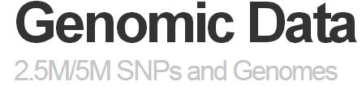
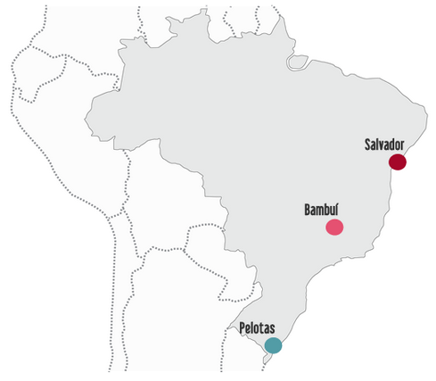
Three most populated Brazilian regions
Population-based Cohorts:
Salvador children
n=1246
16 years follow-up
Ageing cohort Bambuí
n=1442
16 years follow-up
Birth-cohort Pelotas
  n=3653
  33 years follow-up
HumanOmni2.5-8
2.3 M SNPs

Slide 4
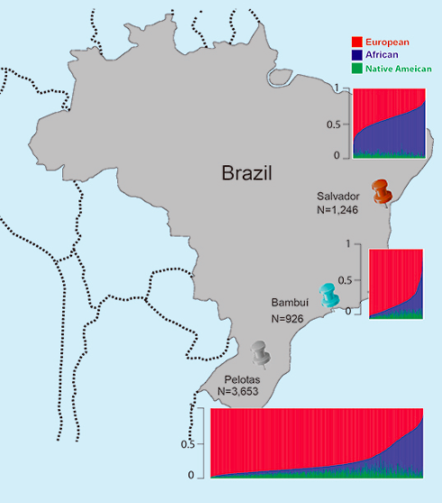
EUR 43%
AFR 50%
NAT 7%
Tri-hybrid ADMIXTURE Analysis, k = 3
EUR 77%
AFR 16%
NAT 7%
EUR 76%
AFR 16%
NAT 8%
370 K SNPs

Slide 5
HOW ADMIXTURE AND THEIR DISTICT DEMOGRAPHIC HISTORIES INFLUENCED THE GENETIC STRUCTURE OF THESE POPULATIONS?
WHAT IS THE PATTERN OF SUBCONTINENTAL ANCESTRY IN DIFFERENT BRAZILIAN POPULATIONS?
(3) HOW WAS THE DYNAMICS OF CONTINENTAL ANCESTRY ACROSS THE THREE BRAZILIAN COHORTS?
(4) WHAT DOES WGS TELL US ABOUT BRAZILIAN DIVERSITY?

Slide 6
(1)
HOW ADMIXTURE AND THEIR DISTICT DEMOGRAPHIC HISTORIES INFLUENCED THE GENETIC STRUCTURE OF THESE POPULATIONS?

Slide 7
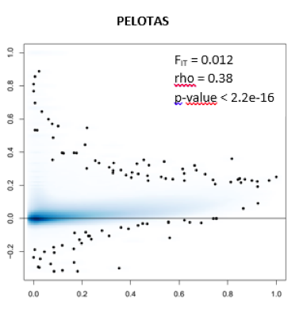
EXCESS OF HOMOZIGOSITY IS CORRELATED WITH EUROPEAN-AFRICAN F_{ST} ACROSS THE THREE COHORTS: POSITIVE ASSORTATIVE MATING BY ANCESTRY
F_{IT}
F_{ST} EUROPEAN-AFRICAN

Slide 8
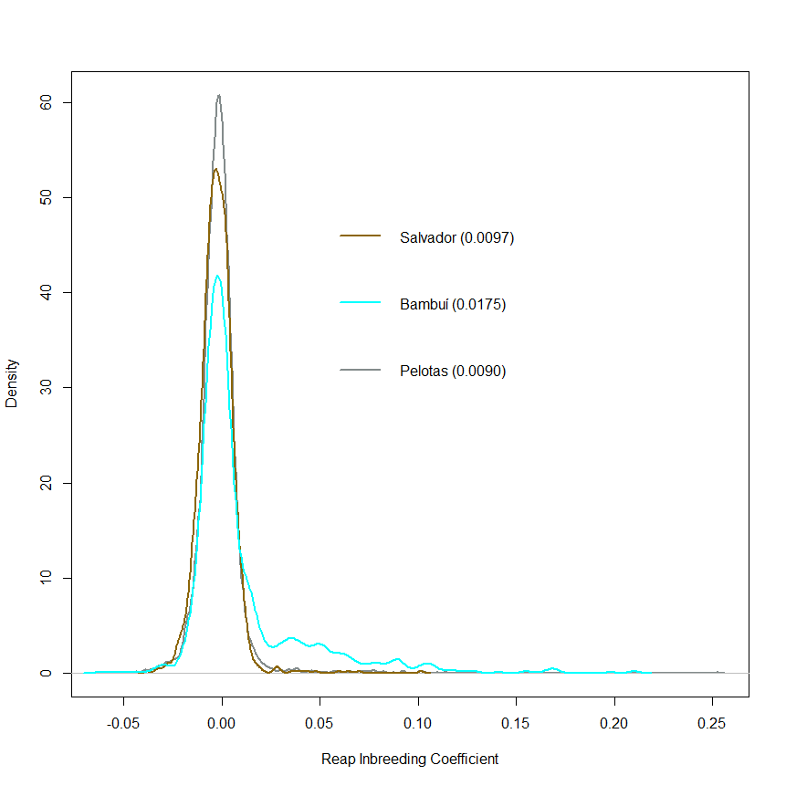
Distribution of inbreeding coefficients estimated by REAP (Thornton et al. 2012, conditioning on tri-hybrid admixture)
Salvador, 2.7 Millions, 0.001
Bambuí (15000),0.012
Pelotas (medium size, 240 000), 0.002
0.00

Slide 9
How admixture and their distict demographic histories influenced the genetic structure of these populations?
Salvador lighter influence of both inbreeding and population subdivision (F_{IT}=, 0.003, F_{IS}=-0.001, rho_{FIT-FST}=0.08, p<10⁻¹⁶).
Salvador, 2.7 Millions
Bambuí , the highest F_{IT} =0.016, due to inbreeding (F_{IS}=0.012) and ancestry-based population subdivision (rho_{FIT-FST}=0.18, p<10⁻¹⁶)
Bambuí (15000)
Pelotas, no inbreeding (F_{IS}=-0.002), the strongest ancestry-based population subdivision (F_{IT}=0.012, rho_{FIT-FST}= 0.38, p<10⁻¹⁶)
Pelotas (medium size, 240 000)

Slide 10
How admixture and their distict demographic histories influenced the genetic structure of these populations?
- Assortative mating by relatedness and by ancestry have modeled the genetic structure of Brazilian populations in different ways
Departure from HW equilibrium is real in admixed populations and should not be applied when performing QC-filtering data, and should be considered in association tests for GWAS

Slide 11
(2)
WHAT IS THE PATTERN OF SUBCONTINENTAL ANCESTRY IN DIFFERENT BRAZILIAN POPULATIONS?
Principal Component Analysis (eigenstrat) and model-based unsupervised ADMIXTURE analysis (Alexander et al. 2010)
We left one individual for each set of related individuals

Slide 12
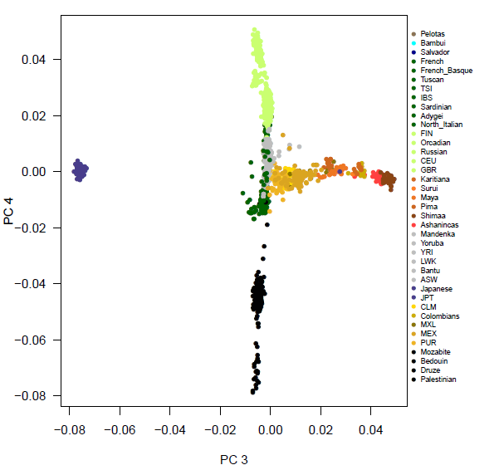
PCA: World Parental Populations (HGDP, HapMap, 1KG Project)
331.792 SNPs
8002 individuals
NORTH EUROPE
SOUTH EUROPE
MIDDLE EAST

Slide 13
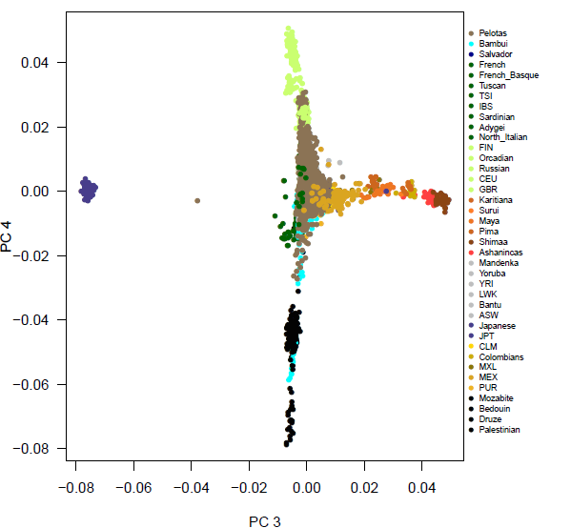
PCA: World Parental Populations and Brazilians
331.792 SNPs
8002 individuals
NORTH EUROPE
NATIVES
SOUTH EUROPE
MIDDLE EAST

Slide 14
WHAT IS THE PATTERN OF SUBCONTINENTAL ANCESTRY IN DIFFERENT BRAZILIAN POPULATIONS?
EUROPEAN ANCESTRY:
An important component of European diversity, not restricted to the Iberian Peninsula, and including part of Northern European and Middle Eastern diversity is present in Brazilians

Slide 15
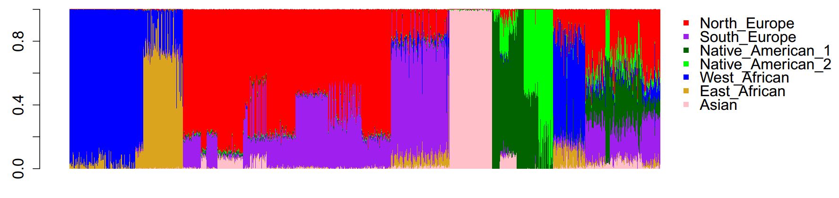
WHAT DO BRAZILIANS TELL US ABOUT AFRICAN DIVERSITY?
Brazil: ~4 000 000 African slaves (longer slave trade)
US: ~560 000 African slaves
Admixture Analysis, K = 7
Parental Populations and Brazilians with >70% African ancestry (n=204)
K = 7
AFRICANS
Europe
Middle East
Natives
MEX
PUR
CLM
JPT
ASW

Slide 16
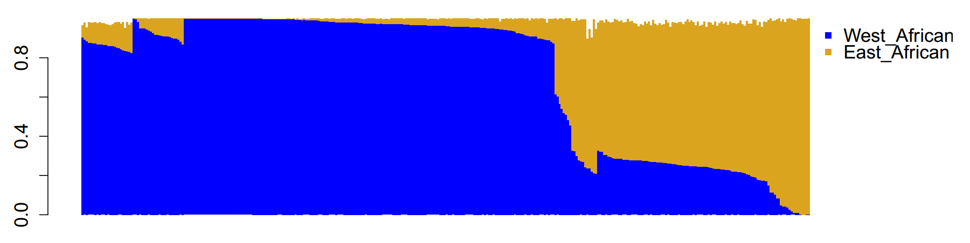
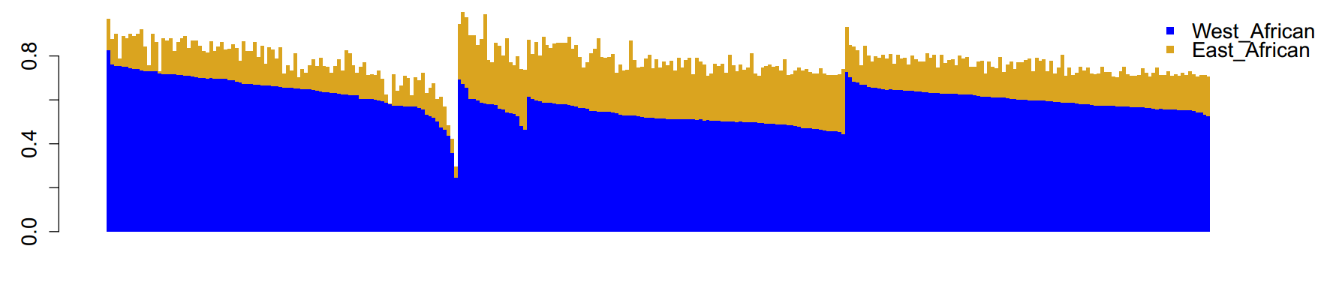
West x East/Bantu associated African clusters and Brazilians (>70% African)
Mandenka
Yoruba
Bantu
LWK
5%
27%
25%
15%
ASW
Bambuí (SE)
Pelotas (S)
Salvador

Slide 17
East Africa x West Africa and Brazilians (>70% African)
Western-associated cluster
Eastern-associated cluster
More slave trade from Western Africa, like ASW
Slave trade also from Angola, Mozambique
(Eastern Africa)
5%
27%
25%
15%
ASW
Bambuí (SE)
Pelotas (S)
Salvador (N)

Slide 18
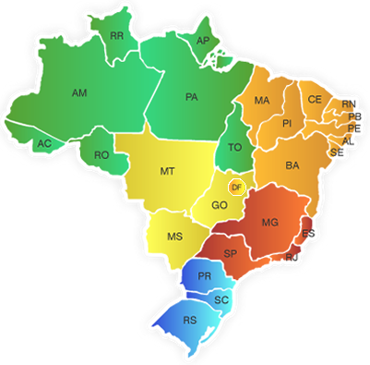
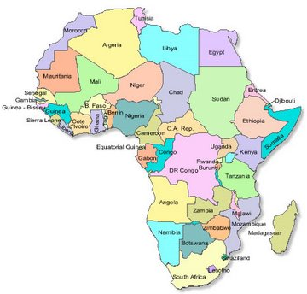
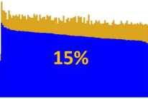

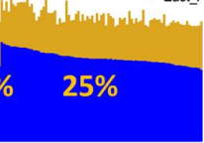

Slide 19
WHAT IS THE PATTERN OF SUBCONTINENTAL ANCESTRY IN DIFFERENT BRAZILIAN POPULATIONS?
AFRICAN ANCESTRY:
WE OBSERVE THE SAME PATTERN IF WE RUN THE ANALYSES WITH ALL THE INDIVIDUALS
BRAZILIANS HAVE THE SIGNATURE OF GENOMIC VARIATION FROM DIFFERENT AFRICAN REGIONS, INCLUDING SOUTH-CENTRAL AND EASTERN AFRICA
SALVADOR (NE), THE MOST AFRICAN BRAZILIAN CITY, SIMILAR TO AFRICAN-AMERICAN
SE AND SOUTHERN BRAZILIANS, MORE EUROPEAN, BUT HOST DIVERSITY FROM ANGOLA, MOZAMBIQUE

Slide 20
(3)
HOW WAS THE DYNAMICS OF CONTINENTAL ANCESTRY ACROSS THE THREE BRAZILIAN COHORTS?
Parental populations: 1000 Genomes and Natives
Phased by SHAPEIT
Local ancestry estimated by PCAdmix

Slide 21

Admixture Dynamics Inference
Parental Populations
Length of chromosomal segments of distinct ancestry -> number of generation since admixture
Time
Generations of admixture
Notes:
Another application for chromosomal ancestry is the inference of admixture history and admixture dynamics.
Soon as an admixed population arises its easy to imagine that the chromosomes of admixed individuals are entirely or almost entirely of a single ancestry. CLICAR
Over the generations CLICAR 3X, due to recombination process, the chromosomal segments of distinct ancestries are being reshaped and rearranged. In other words, the chromosomal segments of distinct ancestries will be spliced into smaller pieces as the number of generations increases since admixture event.
Thus, recently admixed individuals contain many more long chromosomal segments of distinct ancestry than earlier admixed individuals.
CLICAR
So, information regarding the average length of chromosomal segments of distinct ancestry can be useful to infer the number of generation since admixture.
CLICAR
There are statistical methods to infer this parameters like “TRACTS” that was developed by Simon Gravel in this paper.

Slide 22
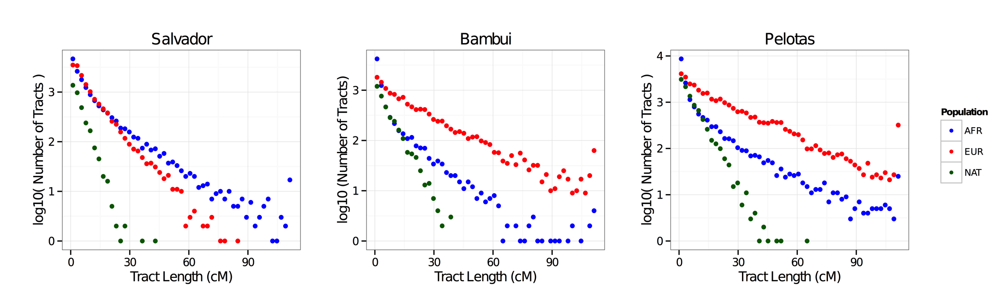
HOW WAS THE DYNAMICS OF CONTINENTAL ANCESTRY ACROSS THE THREE BRAZILIAN COHORTS?
Chromosome 20
No large fragments of Native American ancestry across the three populations
Distribution of tract-lenghts of African ancestry is similar across the three cohorts, with short to large segments, suggesting a similar dynamics
Deficit of large segments of European ancestry in Salvador, suggesting no recent European ancestry, differently from Bambui and Pelotas

Slide 23


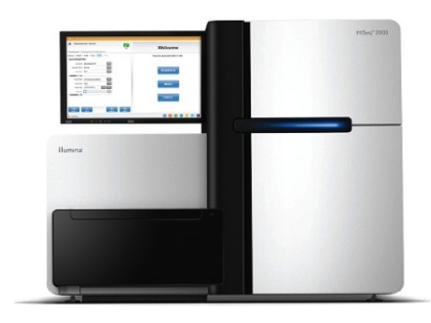
(4) WHAT DOES WGS TELL US ABOUT BRAZILIAN DIVERSITY?
(COVERAGE: 42.7 X)
3649 Pelotas
6222 samples
~2.3M SNPs
HumanOmni2.5-8
1354 Bambuí
1219 Salvador
87 Pelotas
265 samples
~4.3M SNPs
88 Bambuí
HumanOmni5-Quad
90 Salvador
30 samples
whole-genome sequencing
HiSeq 2000
10 Pelotas
10 Bambuí
10 Salvador

Slide 24
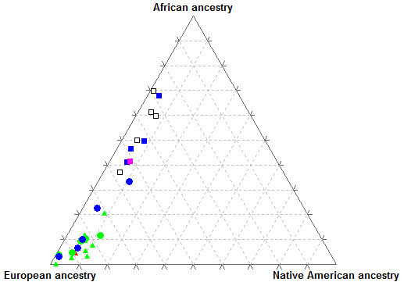



BRAZILIAN WHOLE GENOMES
Moara & Rennan

Slide 25
SNPs (Q ≥ 20)
137
790,510
1,670,170
8,763,719
12,572,149
681
25,679,914
14,727
Total
EPIGEN: 15,033,927
dbSNP137: 47,806,292
1KGP: 38,267,471

Slide 26
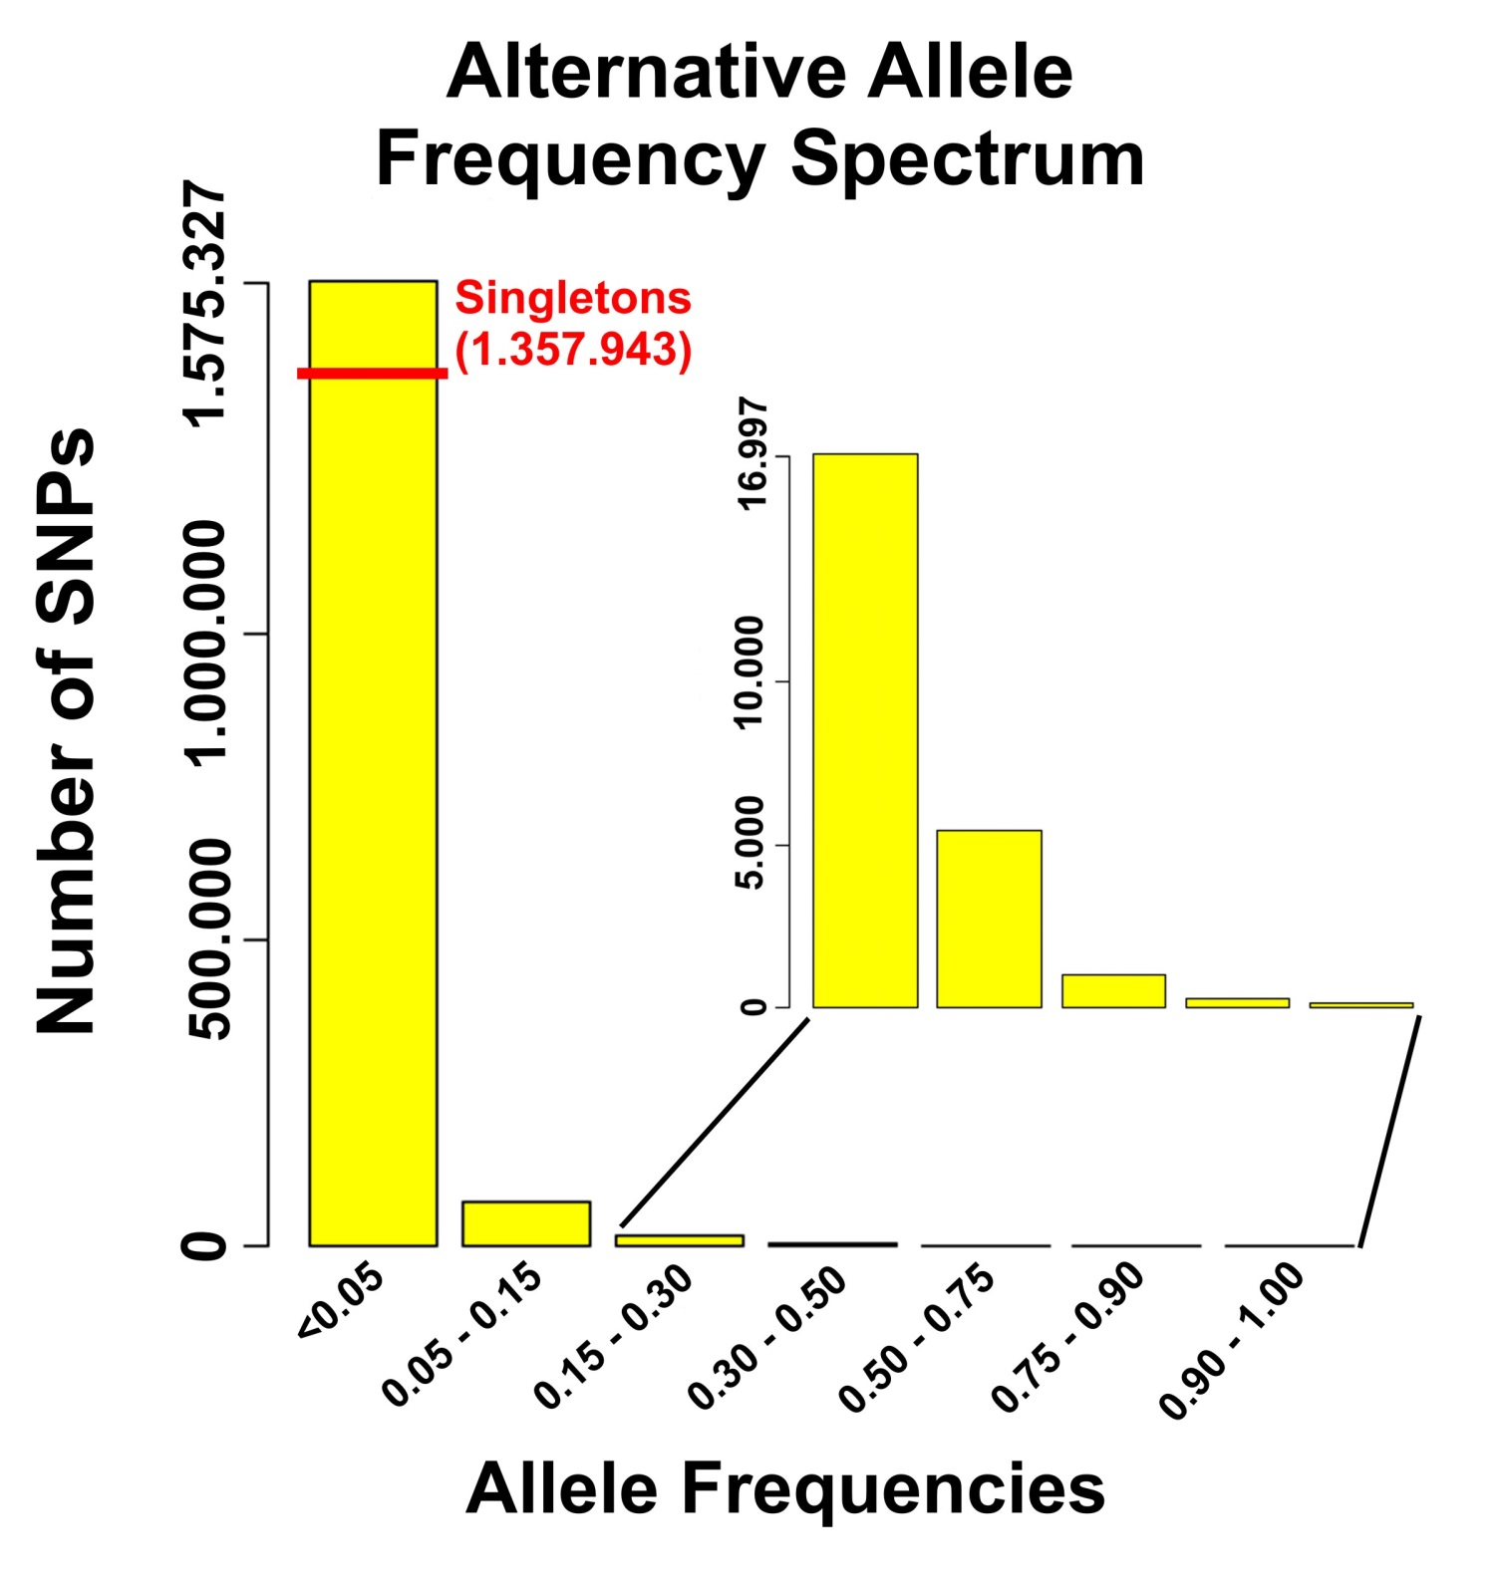
Non-reference
983
268
121

Slide 27
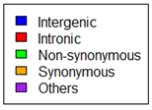
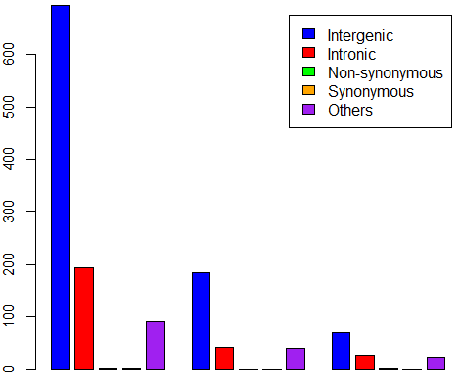
Non-Reference Allele Frequency Spectrum
800,000
600,000
Number of SNPs
400,000
71
25
15
2
2
2
0
0
0
200,000
0
≤0.05
0.05-0.15
0.15-0.25
0.25-0.50
0.50-0.75
0.75-0.90
0.90-1.00
Allele Frequencies

Slide 28
Non-reference
Are these unknown common variants in East African, Native American populations?
983
268
121

Slide 29
EPIGEN Project Board
Maria Fernanda Lima-Costa (FIOCRUZ, MG), Bambui cohort,
Bernardo Lessa Horta (UFPel, RS), Pelotas cohort
Mauricio Barreto (UFBA, BA), Salvador cohort
Alexandre Costa Pereira (INCOR-USP, SP)
Eduardo Tarazona Santos (UFMG, MG)

Slide 30





EPIGEN GENOMIC ANALYSIS GROUP
UFMG
MAIRA RODRIGUES
(BIOINFORMATICS)
ALEXANDRE COSTA PEREIRA
ANDREA HORIMOTO
(INCOR)
WAGNER MAGALHÃES
HAPLOTYPES/INPUTATION)
FERNANDA KEHDY
(POPULATION STRUCTURE)
COMPUTATIONAL SUPPORT: CEBIO – CPqRR, SINAPAD (UFMG, UFRGS)

Slide 31
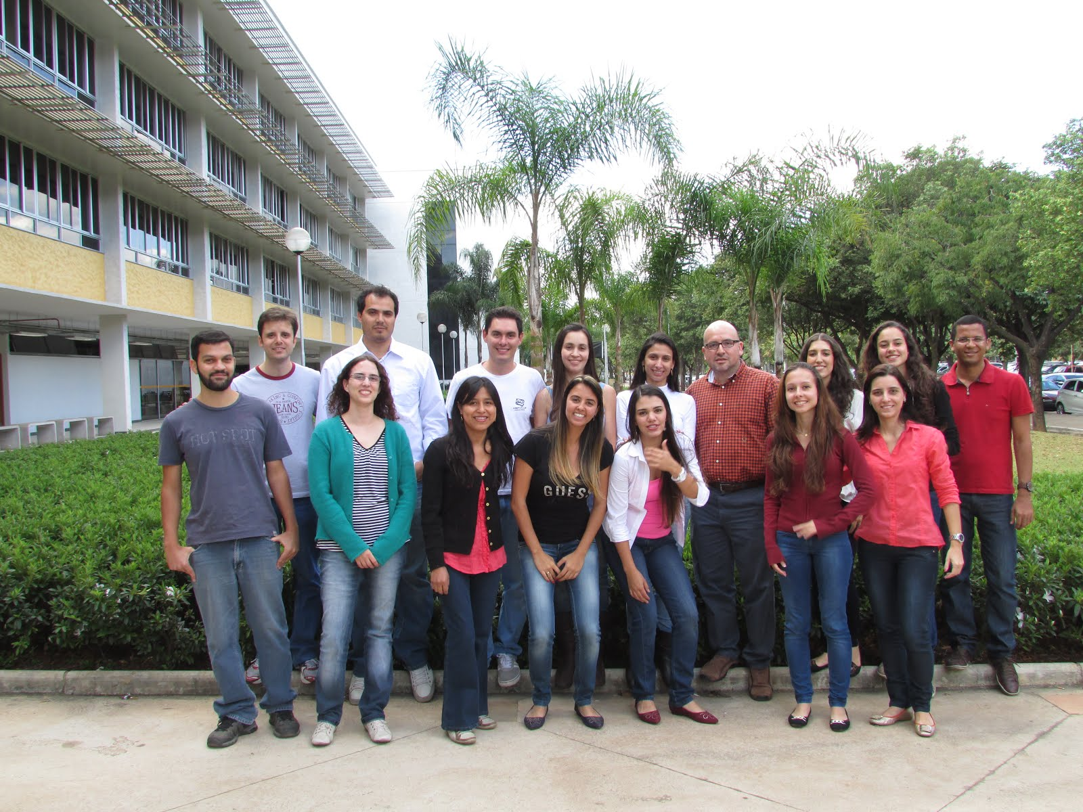



LABORATORY OF HUMAN GENETIC DIVERSITY, UFMG
Bionfo
UFMG

Slide 32
Levels of ancestry
Individual ancestry
Chromosomal ancestry
AFR
EUR
NAT
Chr 1
Chr 2
Chr 3
Chr ...
Infer chromosomal ancestry -> infer the ancestry of each point of each chromosome of each individual.
Indiv 1
0.19
+
0.64
+
0.17
= 1.0
Indiv 2
0.24
0.65
0.11
Indiv 3
0.13
0.80
0.07
Indiv 4
0.14
0.71
0.15
Indiv 5
0.83
0.14
0.03
average
0.31
0.59
0.10
Population ancestry
African
European
Native American
Notes:
So, all the ancestry levels measures are correlated.
In brazilian population contest, individual ancestry is the percentage of individual genome that are from Africa, Europe and America whose values ​​add up to 1. CLICAR
CLICAR. Therefore, the individual ancestry is the average ancestry across all points of all chromosomes of an individual.
CLICAR.The population ancestry is the average ancestry across all individuals of a population.
All these parameters is what we try to estimate in ancestry studies. Here I will concentrate in Chromosomal ancestry CLICAR remembering that CLICAR infer the chromosomal ancestry means to infer the ancestry of each point of each chromosome of each individual.

Slide 33
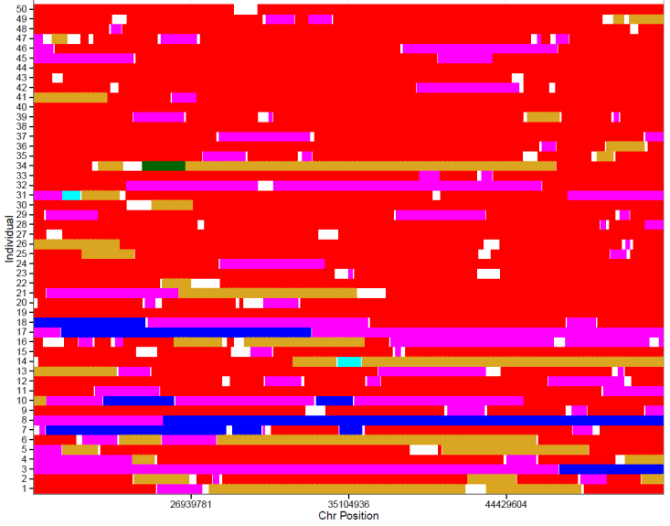
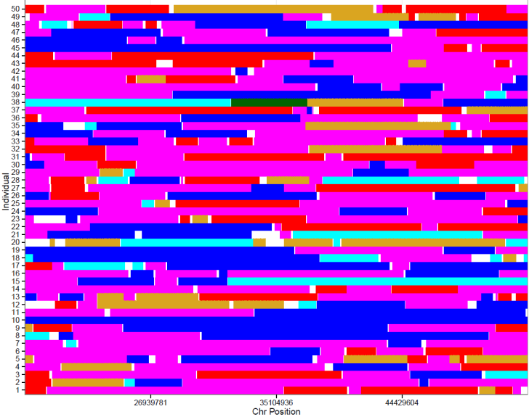

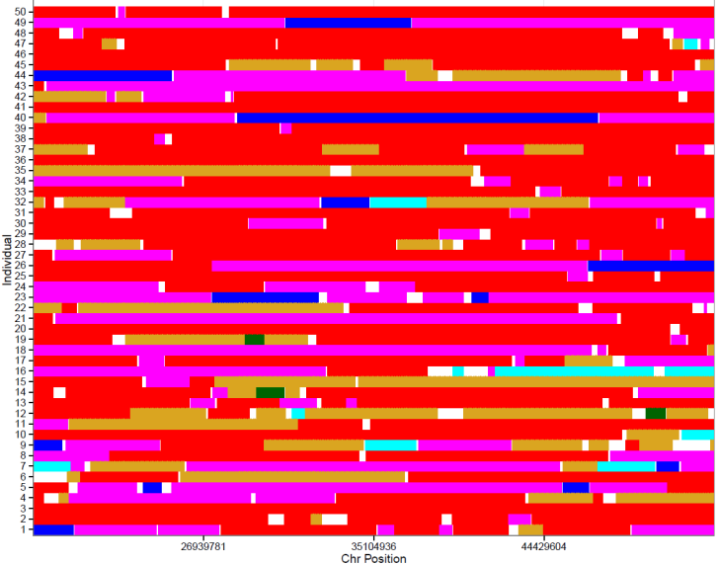
Chr 22 ancestry Results
Individual chromosomal ancestry : 20 individuals -> SABER+ results (10,459 SNPs)
Bambuí
Salvador
Pelotas
Not estimated
AFR + AFR
EUR + EUR
NAT + NAT
AFR + EUR
AFR + NAT
EUR + NAT
Notes:
These are the results of our chromosomal ancestry inferred by SABER+ software, using around 10 thousand SNPs of chromosome22.
These graphs represent chromosomal ancestry of 20 individuals of each cohort Bambuí, Salvador and Pelotas.
The X axis represents the positions of chromosome 22 where each point corresponds to a SNPs.
CLICAR
Each line represents the two homologues of a single individual. The colors represent the different combination of chromosomal ancestry at each SNP. For example: for all these SNPs, in red, both homologues of this individual are from Europe. For these SNPs, in purple, the individual has 1 homologue from Africa and other from Europe.
CLICAR
We can see a predominance of European ancestry in Brazilians (predominance of red regions), however, there is a greater African ancestry in Salvador (purplle and blue regions) compared to the other cohorts.
These data corroborate the results found for population ancestry using whole genome data.

Slide 34
What are the applications of chromosomal ancestry?
Admixture Mapping
Searching for post -Columbian Natural Selection
Admixture Dynamics inferences
Notes:
But what are the applications of chromosomal ancestry?
It can be useful in Admixture Mapping that Eduardo showed yesterday, in searching for post- columbian Natural Selection and for admixture Dynamics Inference.

